Slide 1
Individual Differences

Slide 2
Individual Differences
Individual differences are skills, personalities, abilities, perceptions, attitudes, emotions, etc…
Their effects on organizational behavior are best understood through an interactional perspective:
Behavior is a function of continuous, multidirectional interaction between person factors and situation factors
LECTURE 3: Emotion ∙ Intelligence ∙ Personality

Slide 3
Basics of Affect and Emotion
Affect is the instinctive feeling a person experiences in response to stimuli. It manifests as:
Emotion: Brief yet intense affect caused by an event
Mood: Enduring yet mild affect with no one cause
Emotions directly impede or interrupt thought processes in the present moment and often trigger action (or the intent to act), while moods indirectly alter perception and cognition by biasing it in mood-consistent ways
LECTURE 3: Emotion ∙ Intelligence ∙ Personality

Slide 4
Basics of Affect and Emotion
(Cropanzano, Weiss, Hale, & Reb, 2003; Russell & Barrett, 1999)
LECTURE 3: Emotion ∙ Intelligence ∙ Personality

Slide 5
Basics of Affect and Emotion
Trait affectivity is the degree to which a person has an enduring tendency to experience either positive (Positive Affectivity, PA) or negative (Negative Affectivity, NA) emotions that involve high levels of activation or engagement
PA/NA have been found to:
Directly affect strain (e.g., tension, burnout, pain)
2. Indirectly affect strain by altering perceptions.
3. Make people more/less vulnerable to experiencing stain in response to job stress.
LECTURE 3: Emotion ∙ Intelligence ∙ Personality

Slide 6
Emotional Intelligence
If our emotions shape our perceptions of reality, then Emotional Intelligence (EQ) is the tool that allows us to control our reality
LECTURE 3: Emotion ∙ Intelligence ∙ Personality

Slide 7
Emotional Intelligence
EQ is the ability to monitor your emotions and those of others, to discriminate among them, and to use this information to guide your thinking and actions
EQ covers both intrapersonal and interpersonal domains of intelligence, it is composed of
Self-awareness
Self-management
Social awareness
Relationship management
LECTURE 3: Emotion ∙ Intelligence ∙ Personality

Slide 8
Emotional Intelligence
Emotional intelligence is more changeable or “plastic” than IQ or personality
Well honed EQ allows us access to an additional form of information (emotions) that enhances our ability to make decisions, manage ourselves and our time, think critically, and many other skills
LECTURE 3: Emotion ∙ Intelligence ∙ Personality

Slide 9
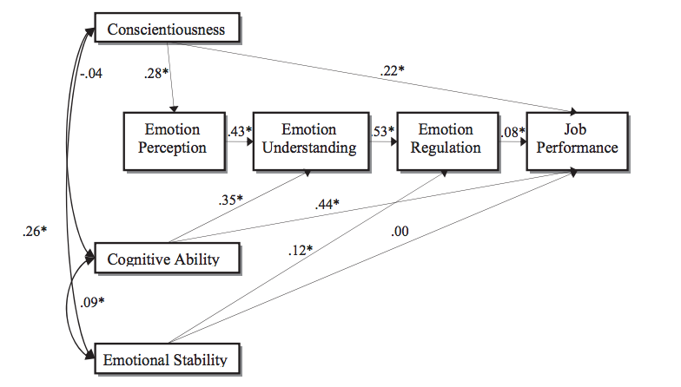
Emotional Intelligence
EQ is linked with increased job performance, and has more of an impact than personality
Joseph & Newman (2010); O’Boyle, Humphrey, Pollack, Hawver, & Story (2011) – both are meta-analyses of over 30,000 people
LECTURE 3: Emotion ∙ Intelligence ∙ Personality

Slide 10
Emotional Intelligence
Greater EQ is linked with better mental and general health, and better physical health as well (to a lesser degree)
Martins, Ramalho, & Morin (2010); Schutte et al. (2007) – meta-analysis of nearly 20,000 people
LECTURE 3: Emotion ∙ Intelligence ∙ Personality

Slide 11
Multiple Intelligences
The remaining intelligences include:
Spatial intelligence
Linguistic/Verbal intelligence
Mathematical/Logical intelligence
Musical intelligence
Bodily-Kinesthetic intelligence
Naturalist intelligence
Intrapersonal intelligence (one part of EQ)
Interpersonal intelligence (other part of EQ)
LECTURE 3: Emotion ∙ Intelligence ∙ Personality

Slide 12
Personality
Personality is the relatively stable set of characteristics that influences an individual’s behavior and lend it consistency
Shaped by genetics (up to 50%) and environment (e.g., family, culture, education, etc.)
LECTURE 3: Emotion ∙ Intelligence ∙ Personality

Slide 13
Personality
Trait Theory: Break down behavior patterns into observable traits
Psychodynamic Theory: Unconscious determinants of behavior
Humanistic Theory: Individual growth and improvement
LECTURE 3: Emotion ∙ Intelligence ∙ Personality
Notes:
7
7
7
7

Slide 14
Personality: Trait Theory
LECTURE 3: Emotion ∙ Intelligence ∙ Personality

Slide 15
Personality: Trait Theory
Which Big 5 factors predict the following?
Performance?
Performance in social interactions?
Performance in customer service?
Team Performance?
Emotional Support?
Creativity or Innovation?
Helping Behavior?
Burnout?
Transformational Leadership?
Occupational Success?
LECTURE 3: Emotion ∙ Intelligence ∙ Personality

Slide 16
Personality: Integrative Theory
A person’s core self-evaluation is the degree to which a person evaluates his/her self (or self-concept) positively
Stronger core self-evaluations can lead to higher:
LECTURE 3: Emotion ∙ Intelligence ∙ Personality

Slide 17
Personality: Integrative Theory
CSE is indicated by four personality constructs:
Locus of Control: Belief that the events in one’s life are mostly controlled either by oneself (internal) or by the situation or others (external)
Emotional Stability: As discussed in the Big 5 (does not often experience negative emotional states, e.g., anxiety, hostility, depression, etc.)

Slide 18
Personality: Integrative Theory
CSE is indicated by four personality constructs:
Self-Esteem: Overall feelings of self-worth; high self-esteem is associated with positive feelings and emphasizing strengths over weaknesses
Self-Efficacy: Overall belief of how effectively one can perform, cope, or succeed in various situations
LECTURE 3: Emotion ∙ Intelligence ∙ Personality

Slide 19
Personality: Integrative Theory
One more critical personality disposition:
Self-Monitoring: The degree to which people base their behavior on cues from people and situations
LECTURE 3: Emotion ∙ Intelligence ∙ Personality

Slide 20
Personality: Measurement
Projective Test: Response to abstract stimuli
Behavioral Measures: Observing an individual’s behavior in a controlled situation
Self-Report Questionnaire: Responses to questions
LECTURE 3: Emotion ∙ Intelligence ∙ Personality
Notes:
16
16
16

